Slide 1
Inferring Species Based on Geodata of Three Birds
Will Caffry

Slide 2
Data Stats
Downloaded from www.movebank.org
Geopoints for three bird species: Bald Eagle, Great Egret, Blue Heron
~1 million points consisting of Latitude, Longitude, datetime, bird ID, and species.
Broke data into groups based on time of day and calculated the distance each bird traveled during that time for every day.

Slide 3
Hypothesis
H₀: There will be no difference in movement patterns between species
H₁: Using clustering analysis and regression I will be able to predict whether a bird is a bird of prey (Bald Eagle) or heron (Blue Heron and Great Egret)
H₂: I will be able to predict species based on movement patterns
H₃: I will be able to predict individual bird identity based on movement patterns

Slide 4
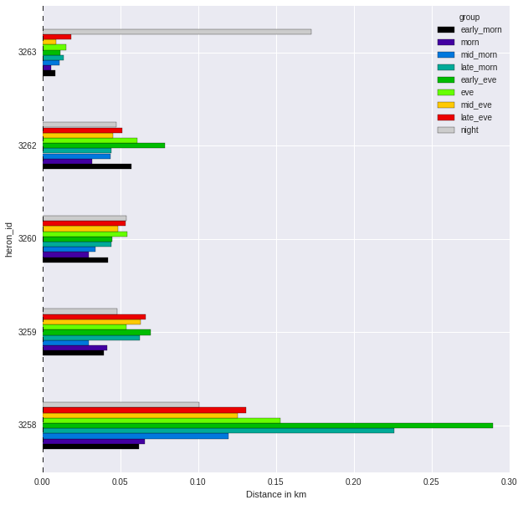
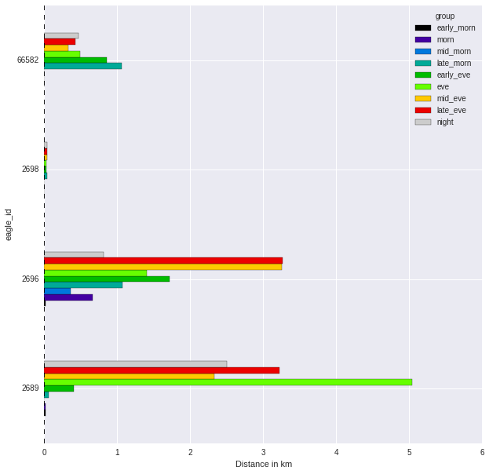
Blue Heron
Bald Eagle

Slide 5
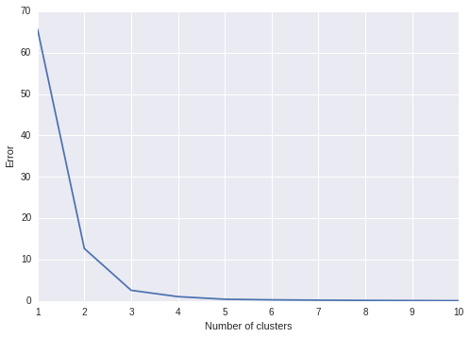
Looking for Clusters with Kmeans
Strong support for either 2 or 3 clusters
Not likely to identify individuals

Slide 6
Regression and Prediction
Not linear relationship
Test Score = -195.1
Logistical Model
Accuracy for whether bird of prey or heron = 1.0!
Accuracy for predicting species = 0.833
Accuracy for predicting individuals = 0.0
Highest weights were for evening time groups

Slide 7
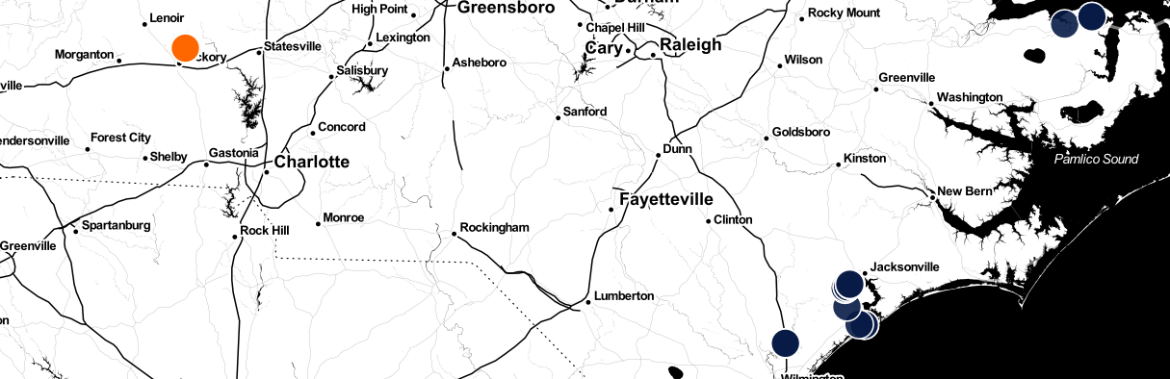
Bald Eagle
Blue Heron
Plotted geopoints for a Bald Eagle and Blue Heron individual over a 2-day timespan

Slide 8
Conclusion/Future Directions
H₁ and H₂ confirmed
H₃ rejected
Incorporate more species to define patterns within larger groups (genus or family)
Incorporate proximity to geological features (rivers, lakes, oceans, mountains…)
Test greater numbers of individuals for a species for potential to define behavior groups within a species

